Slide 1
Translation Bot
Simplicity in an age of complexity

Slide 2



TranslationBot Approach
SINGLE PAGE APPLICATION
AWS LAMBDA FUNCTION
AWS TRANSLATE
French
English
English
French

Slide 3
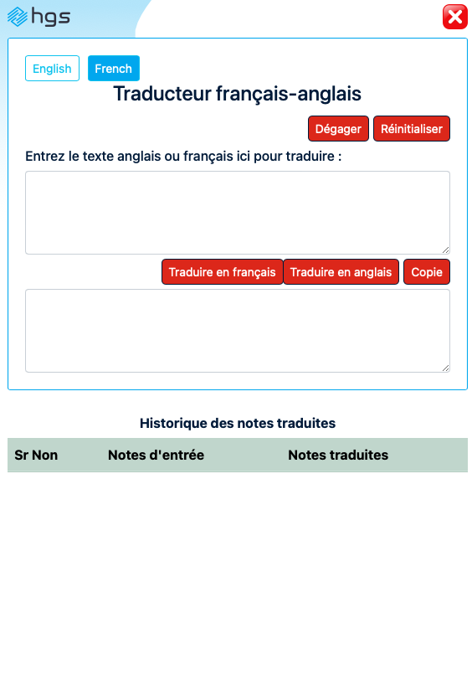
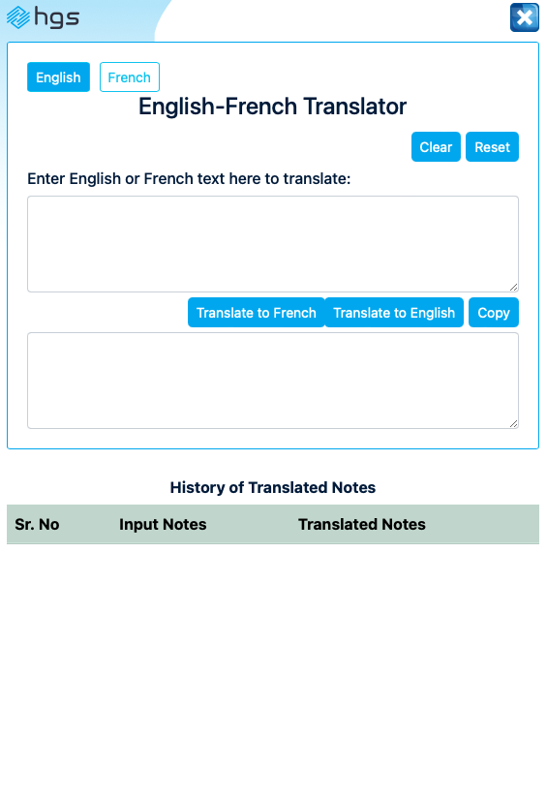
Solution Overview
Dynamic screen window, adjust size as per requirement
Seamless switch over from French to English to French
Agents have option to view historical translated notes to reduce effort in re-translating it again
Secure cloud enabled solution integrated to AWS licensed translation engine
AWS Cloud configured for Canada geography
Higher translation accuracy compared to other free engines
No installation required
Highly scalable and cost-effective solution
Solution will be secured to work within HGS environment
No data storage. Web browser cache is also deleted with 4 different controls in place
  Solution in idle state > 5 mins auto deletes all content
  Solution auto deletes all web browser cache every 15 mins
  Solution exited deletes all web browser cache
  Agent clicking on reset/clear button clears web browser cache

